Slide 1

Oncology Institute Automation (OIA)
Under Supervision of:
Dr. Ahmed I.Taloba
EELU Assiut Center Manager

Slide 2
Team members
Name | ID
Mohamed Ahmed Khalaf | 14-01623
Ahmed Fathy Khalifa | 14-01495
Abdelrahman Mostafa Mohamed | 14-01363
Marwa Mohamed Adel | 14-01753
Nourhan Ahmed Diaa | 14-01421
Shimaa Sayed Abd El-moaz | 14-01433
Heba Nasser Sayed | 14-01641

Slide 3
Agenda
Introduction
Motivation
Problem Statement
Objectives
Survey
Datasets
Tools
Work Plan
OIA System
References

Slide 4
Introduction
Oncology Institute Automation (OIA) automates the old system in the South Egypt Cancer Institute to develop the interface of the old system, make the dealing with the system easier and faster using advanced languages, make the system more secure and add new branch to admin includes several features which makes he is more control in the system.
OIA helps doctors and employees to do the operations and tasks with high performance and in a little time and patients can completion of entry procedures easier.
OIA Divided into several branches such as Reception, Operations, Laboratory, Nutrition, Admin.

Slide 5
Motivation
We are trying to help firstly the patients that suffer from their illness in addition to problems with entry procedures.
Help the user to do operations with good quality and access to any thing in the system easier, there many difficulties to dealing with the system in short period.

Slide 6
Problem Statement
The main problems that we build the OIA system for it:
Patient suffering from traditional procedure
Data complexity
Bad performance & complexity of the old system

Slide 7
Objectives
The system is highly efficient to save time and effort for patients and employees
Ease of data entry by reducing number of screens used for input
Many reports and statistics were made available to the Institute
rebuild the old system from desktop to web application to be access from anywhere
Protect the system and add permissions to users, each user can access only his/her branch

Slide 8
Survey
We visited the oncology institute and met the employees at each branch to extract the details of each branch, the difficulties that face them in using the system, and knew their requirements.
we inspected old system well to avoid mistakes and maked more accurate .

Slide 9
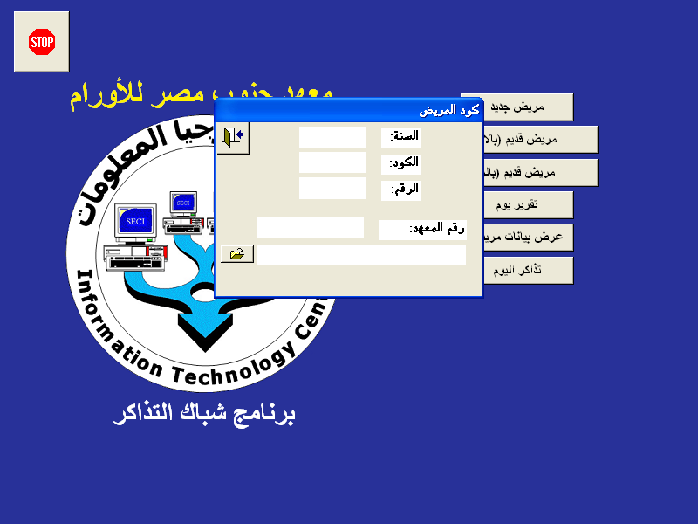
1. Ticket Window Branch
User will print patient ticket , If he is the first time he visits the Institute, he will record his entire data then print ticket and if patient’s data already exist employee will print ticket. When login to ticket window branch, it is available to you: - register new patient or searching about old patient whether using patient name or code . - View patient data - day's report includes a report on regular tickets or chemical injection tickets .

Slide 10
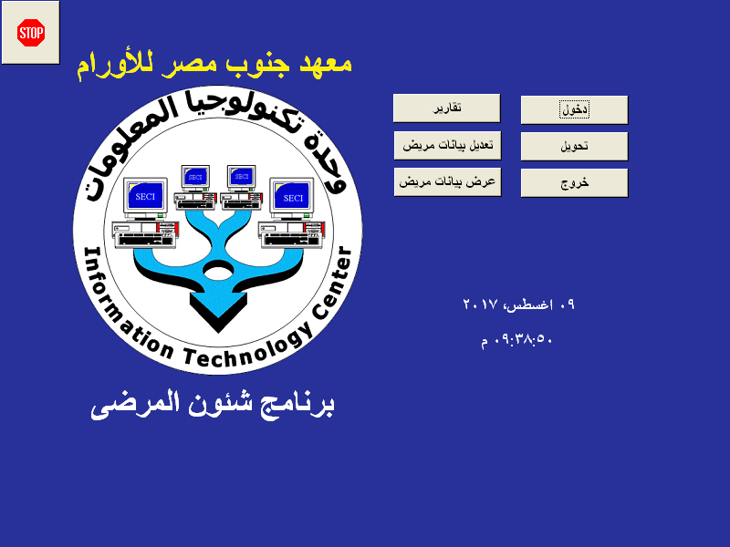
2. Patient Affairs Branch
When login he can access the Patient affairs branch and can do five main functions through this form:
Enter Patient to Institute .
Transform patient from one department to another .
Exit patient from Institute .
Reports .
Edit Patient’s data .
Show Patient’s data .

Slide 11

3. Operation Branch
When login he can access the operations branch and can do three operations in this form :
Surgical procedure registration .
Modified surgical procedure .
Surgical operation presentation .

Slide 12

4. Laboratory Branch
When employee login that can access the Laboratory branch and can do five operations in this form :
Recording analysis results .
Modify analysis results.
Remove analysis .
patient query.
Modify the operating system settings.

Slide 13

5. Nutrition Branch
The nutrition branch is divided according to the ward where the patient is located.
Each patient has a specific nutrition that differs from that of another patient in another ward .

Slide 14
Datasets
The database of oncology institute is very complex because it established from more than 20 years ago, also It very huge which includes 256 tables, some tables include more than 200,000 records. We reused 150 tables from them.
We faced many problems in dealing with this database and we took more than two month to understand and analysis it well.
We make filtering for more than 20,000 records in final diagnosis column in patients table because there is so much records have the same meaning . We made employee in our system choose final diagnosis of patient using live search to avoid the same mistake.

Slide 15
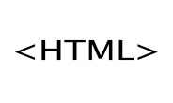







Tools
HTML
CSS
JQuery
Bootstrap
JavaScript
MYSQL
PHP
AJAX

Slide 16
Work Plan
Tasks | Duration | Assigned to
1.Planning | 35 days
1.1 Search for good idea | 5 days | All
1.2 Identify this idea | 5 days | Mohamed
1.3 Survey idea | 20 days | All
1.4 Develop work plan | 5 days | Marwa

Slide 17
Work Plan
Tasks | Duration | Assigned to
2. Analysis | 90 days
2.1 Develop analysis strategy | 5 days | Mohamed
2.2 Determine system requirements | 10 days | Nourhan + shimaa
2.3 Data analysis | 40 days | Abdelrahman + Marwa+ Heba
2.4 System Survey | 30 days | Mohamed + Ahmed + Nourhan + shimaa
2.5 Create use cases | 5 days | AbdelRahman

Slide 18
Work Plan
Tasks | Duration | Assigned to
3. Design | days40
3.1 login page | 2 days | Mohamed + shimaa
3.2 Reception Branch | days10 | Nourhan + Marwa
3.3 Operations Branch | 3 days | AbdelRahman
3.4 Laboratory Branch | 10 days | Ahmed + Nourhan + Heba
3.5 Nutrition Branch | 5 days | Shimaa + Heba
3.6 admin branch | days10 | Mohamed + Marwa

Slide 19
Work Plan
Tasks | Duration | Assigned to
4. Implementation | 55 days
4.1 login page | 5 days | Mohamed
4.2 Reception Branch | 15 days | Mohamed + Ahmed
4.3 Operations Branch | 5 days | Mohamed
4.4 Nutrition Branch | 5 days | Mohamed + Ahmed
4.5 Laboratory Branch | 15 days | Ahmed
4.6 Admin branch | 10 days | Mohamed

Slide 20
Work Plan
Tasks | Duration | Assigned to
5. Documentation & Presentation | 21 days | All

Slide 21
OIA System

Slide 22
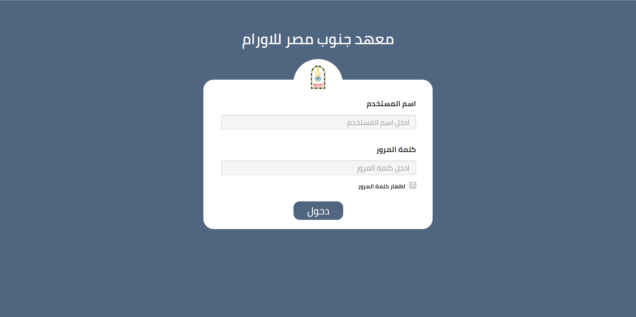
Login
The user enters his username and the password to enter on his own branch .
If user enter his username and password incorrect , then message show to enter again his username and password .
Each user can enter only to own branch . but admin access to all branches .

Slide 23
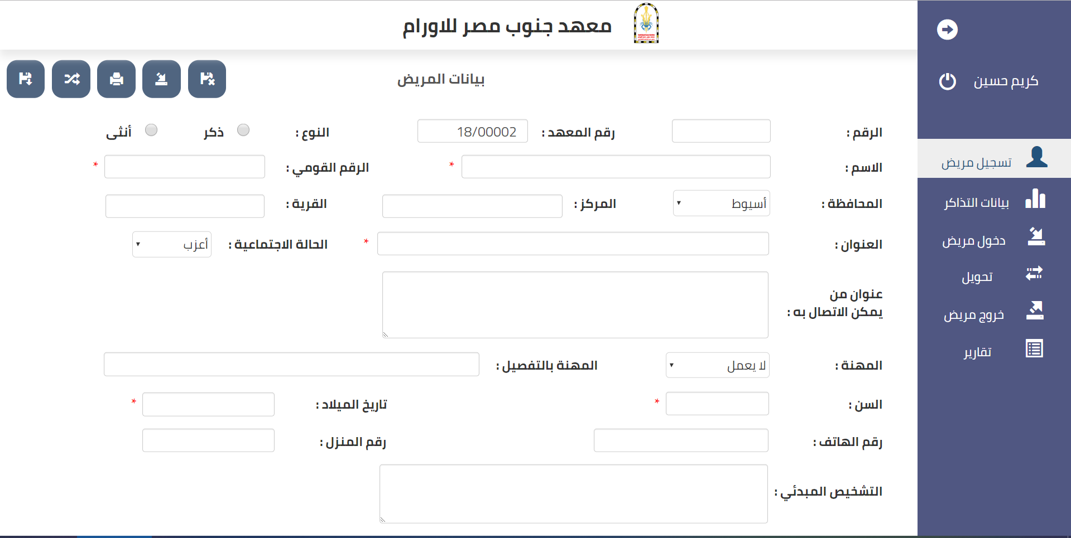
1. Reception Branch
This branch is responsible for registering a new patient at the Institute. If the patient is already present, the user will fill in the patient's admission data. He can modify the patient's data, which transfers a patient from one department to another, responsible for Tickets data , Patient exit registration and write final diagnosis.
There are reports on the admission and discharge of the day, the current patients and current patients in the ward, the number of current patients in the ward, the current patients in the department and the current patients for more than a month.

Slide 24
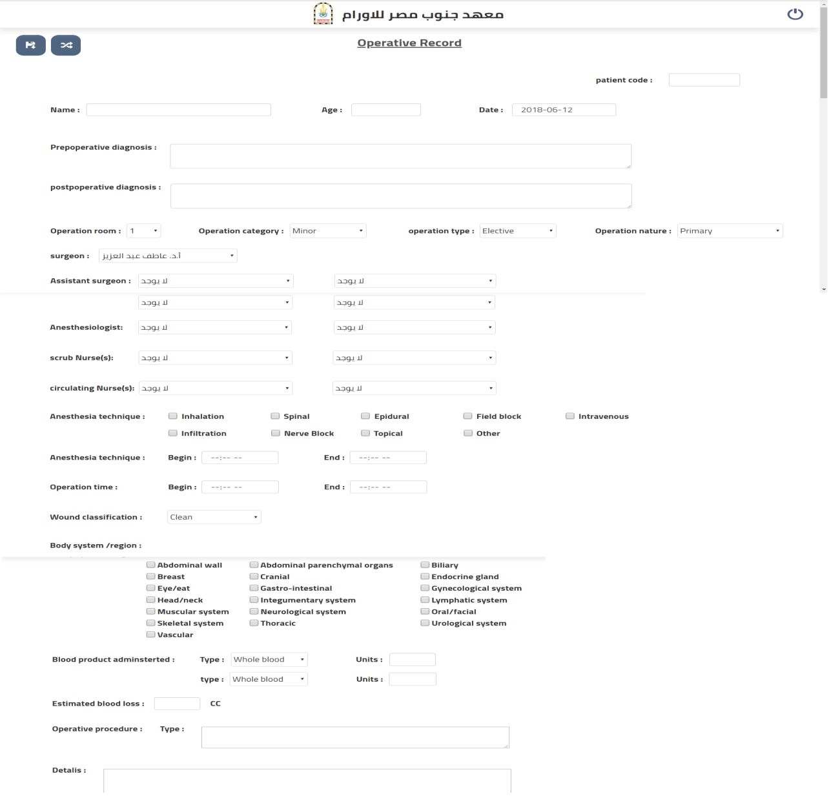
2. Operation Branch
When performing a new surgical procedure, you must first perform the registration process on the system, insert the date of surgery day, and choose the operating room where the operation will take place, Pre-operative diagnosis must be recorded for preoperative condition, and Choose the type of operation, doctor's name, assistant, anesthesiologist, nurse, and anesthesia time .

Slide 25
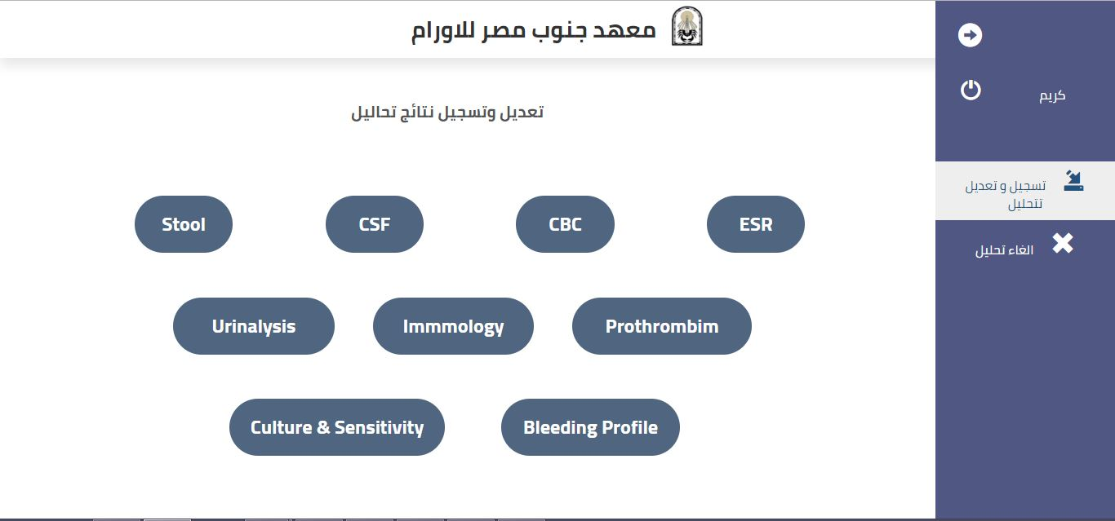
3. Laboratory Branch
This branch enables the user to register and modify analyzes, and contains many types of analyzes , , include :
Stool
CSF (Cerebo spinal fluid)
CBC (complete blood count)
ESR (Erythrocyte Sedimentation Rate)
Urinalysis
immunology
Prothrombin
Culture & Sensitivity
Bleeding Profile
The user can cancel analysis .

Slide 26
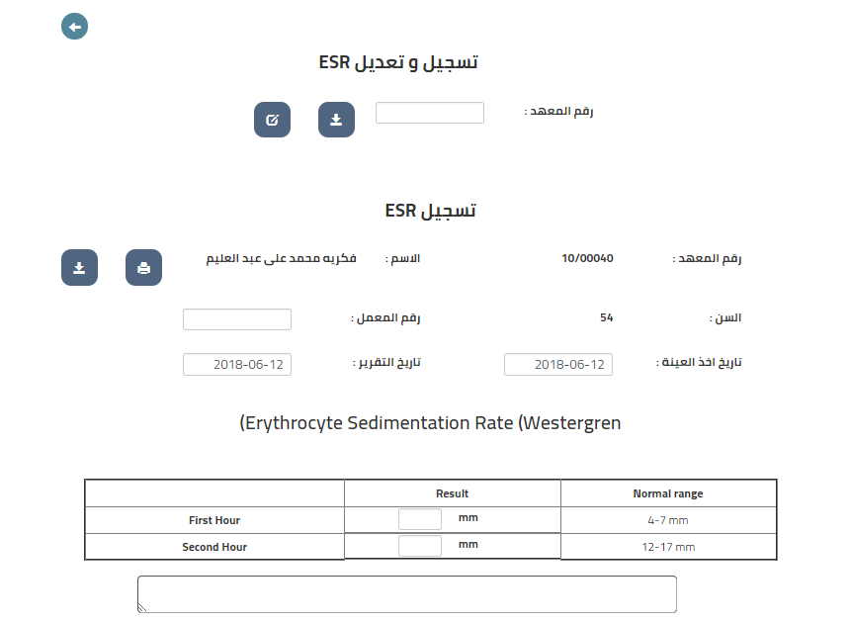
3. Laboratory Branch

Slide 27
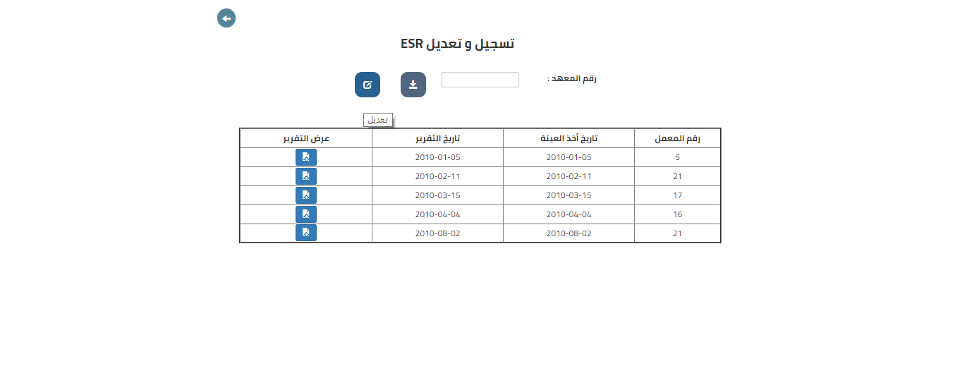
3. Laboratory Branch

Slide 28
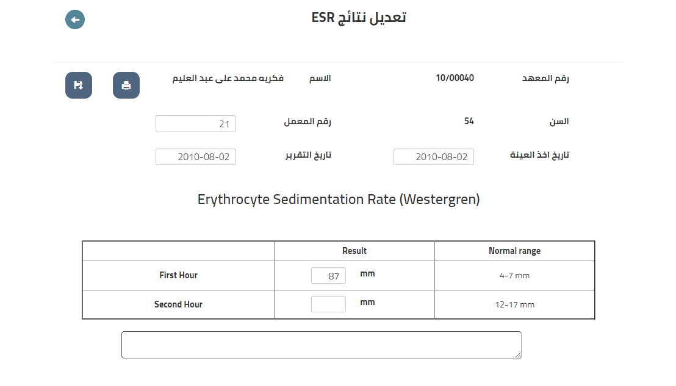
3. Laboratory Branch

Slide 29
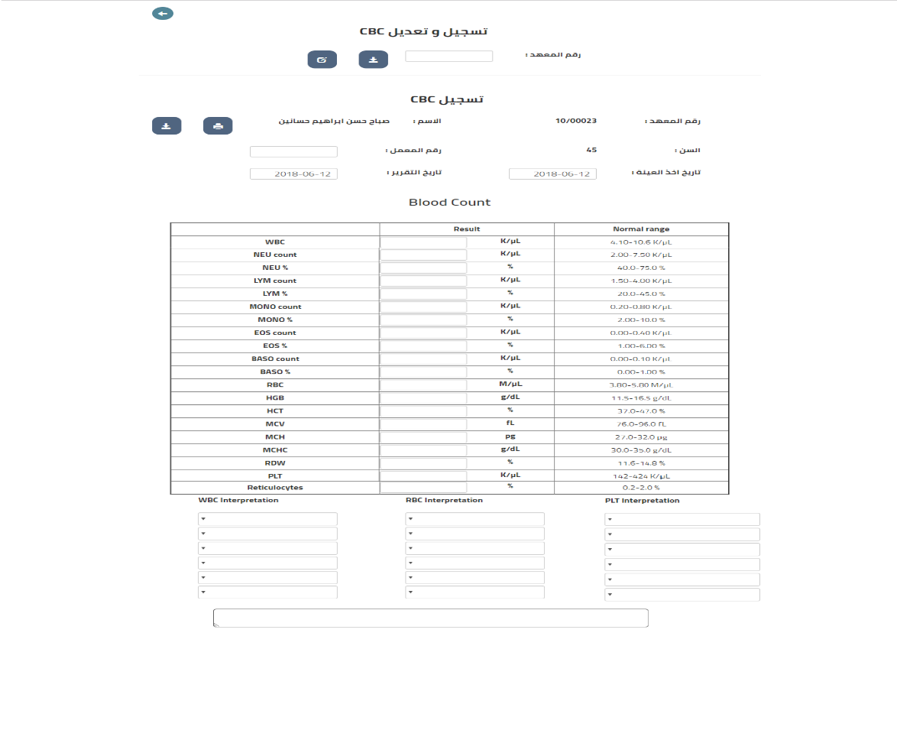
3. Laboratory Branch

Slide 30
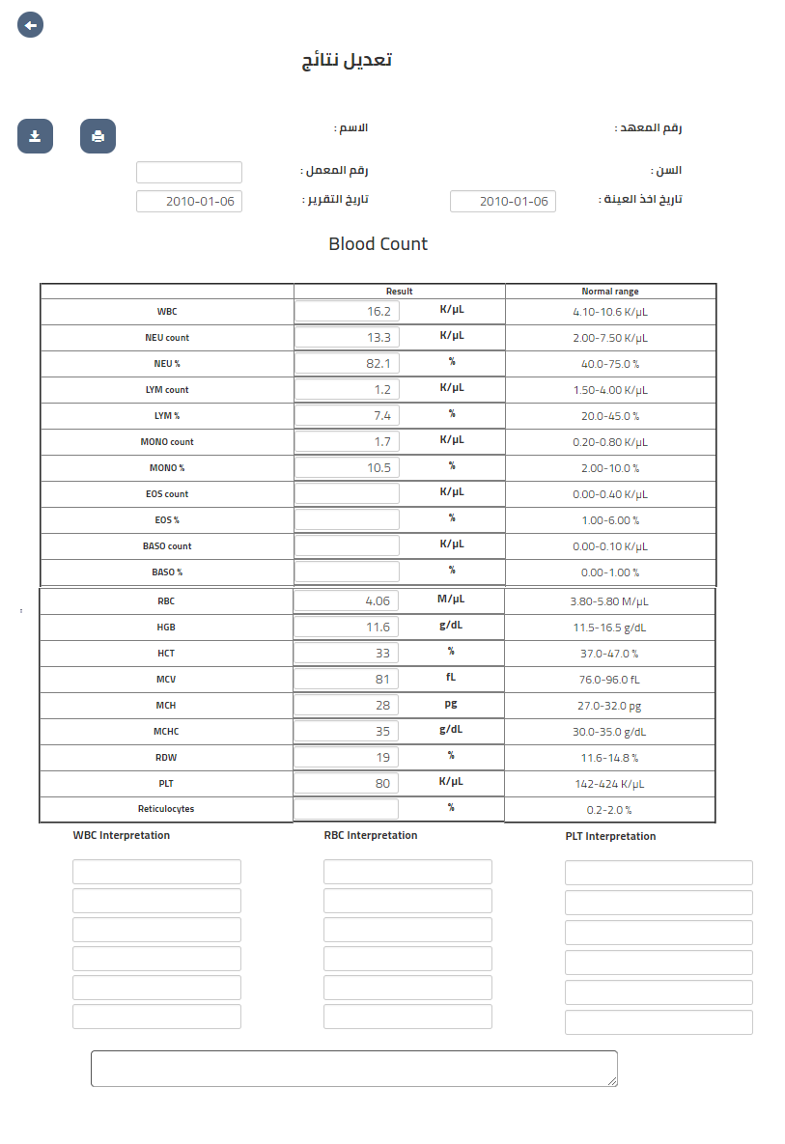
3. Laboratory Branch

Slide 31
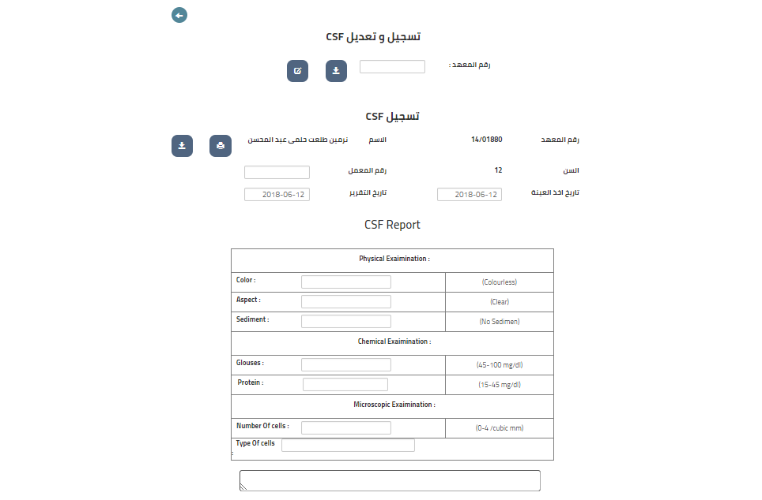
3. Laboratory Branch

Slide 32
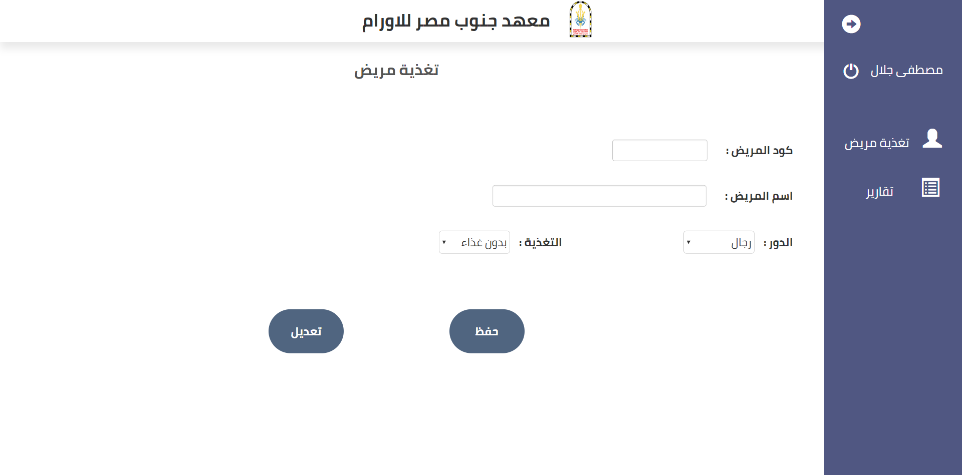
4. Nutrition Branch
Record the nutrition of the patient according to instructions of the doctor.
The food is determined according to the patient's condition and the food he needs.
This branch has reports on every ward of women, men or children, reports on intensive care and a free treatment ward

Slide 33
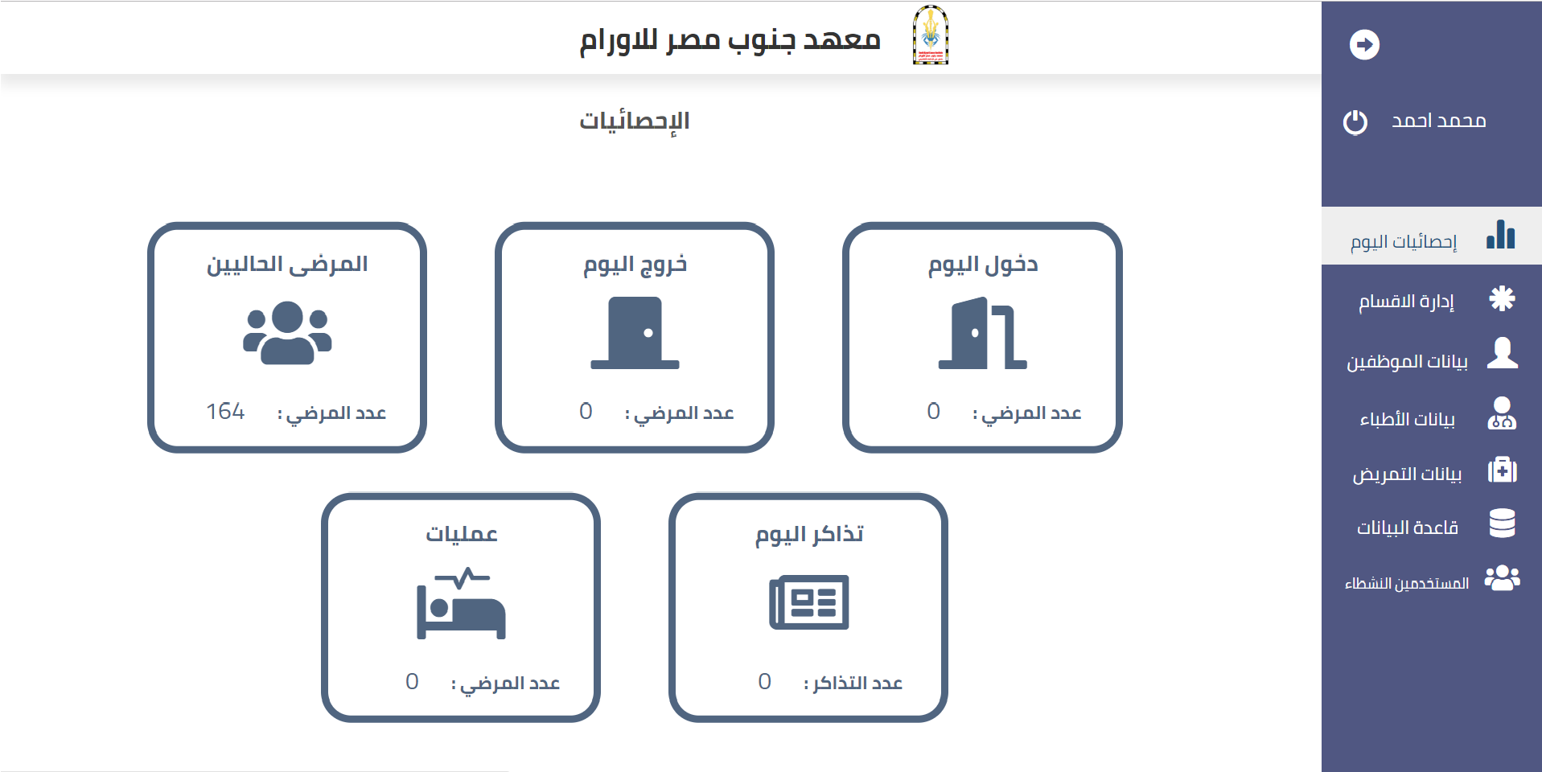
5. Admin
Admin access all branches but each employee only access his own branch , able to control all branches but each employee only control his own branch and the possibility to add or delete an employee ,doctor , nurse or modify the data of an employee ,doctor or nurse . The main page of the Admins includes the statistics of the number of patients who entered this day or the exit of patients on this day or the numbers of patients who performed surgeries on this day and the number of tickets today.
Admin can know who the users active .
Admin able to backup and restore for database.

Slide 34
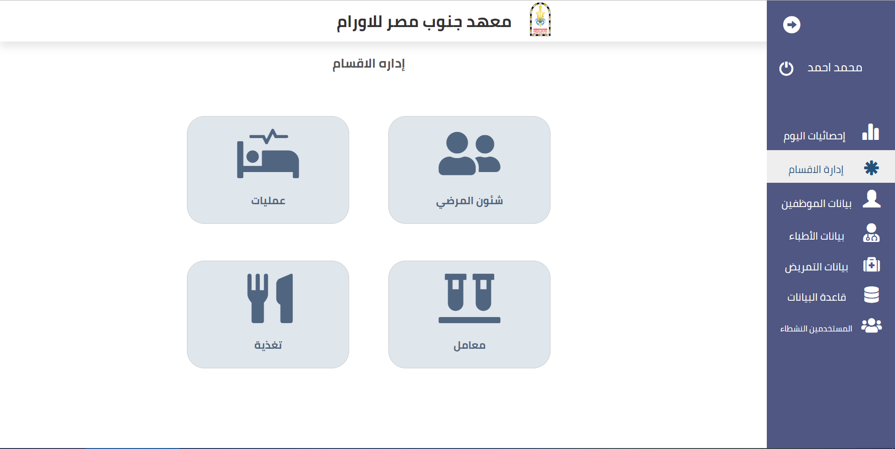
5. Admin

Slide 35
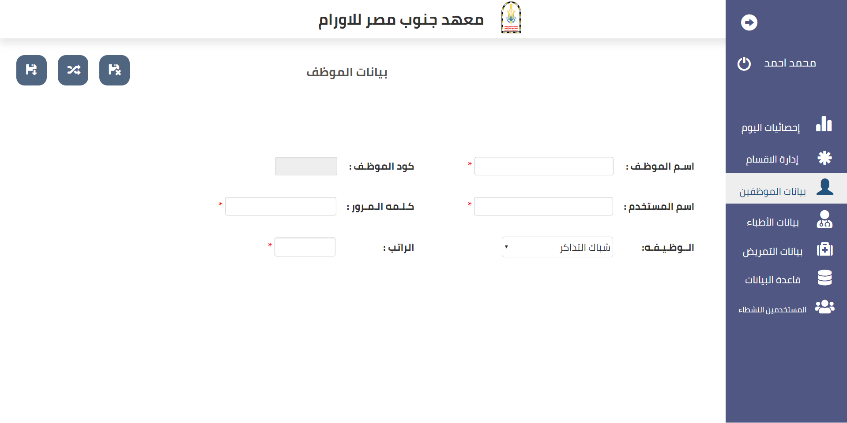
5. Admin

Slide 36
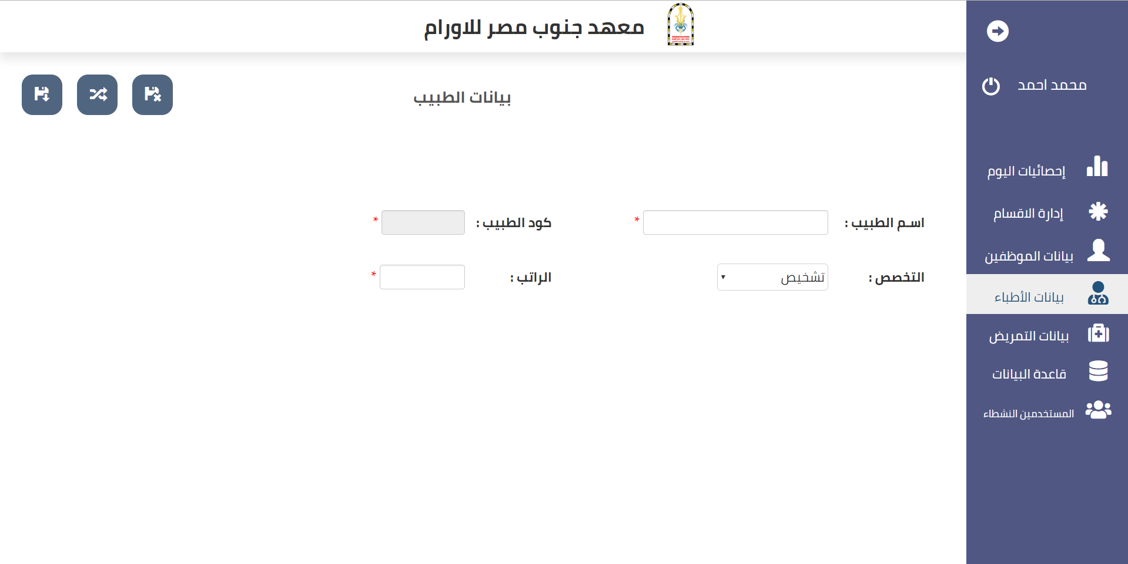
5. Admin

Slide 37
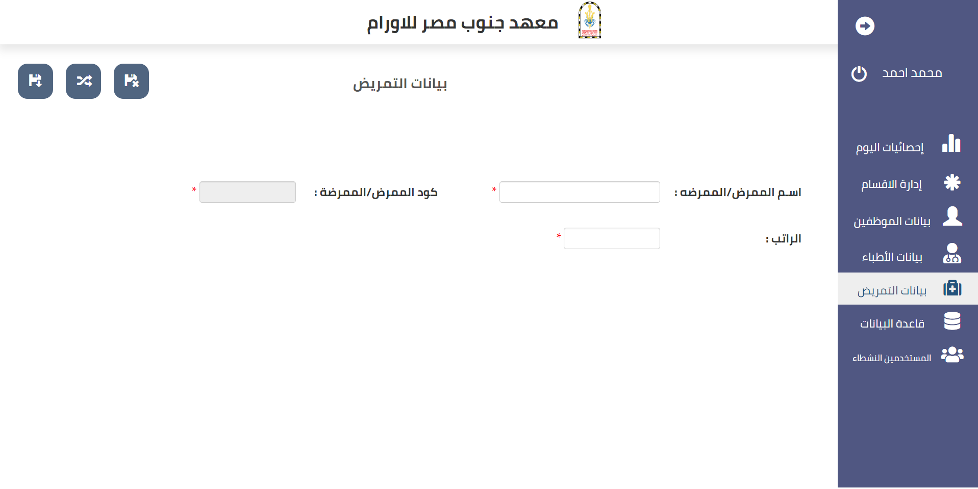
5. Admin

Slide 38
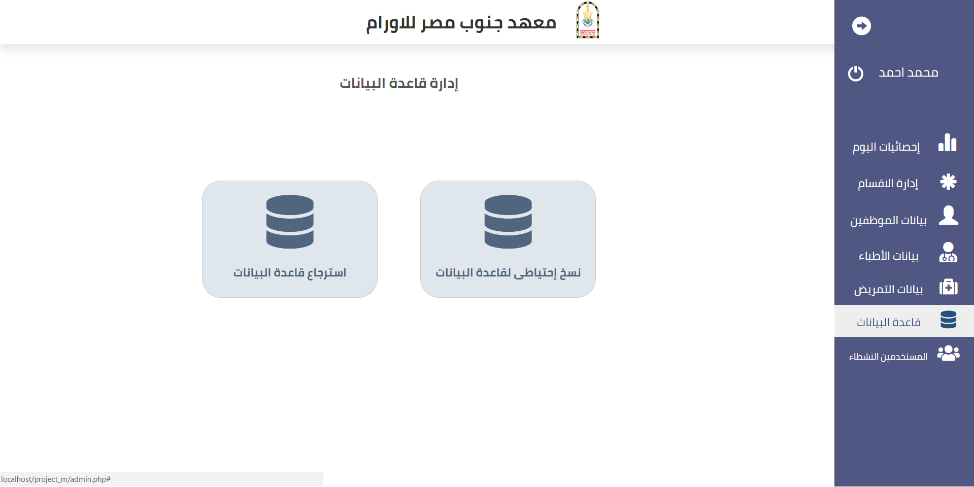
5. Admin

Slide 39
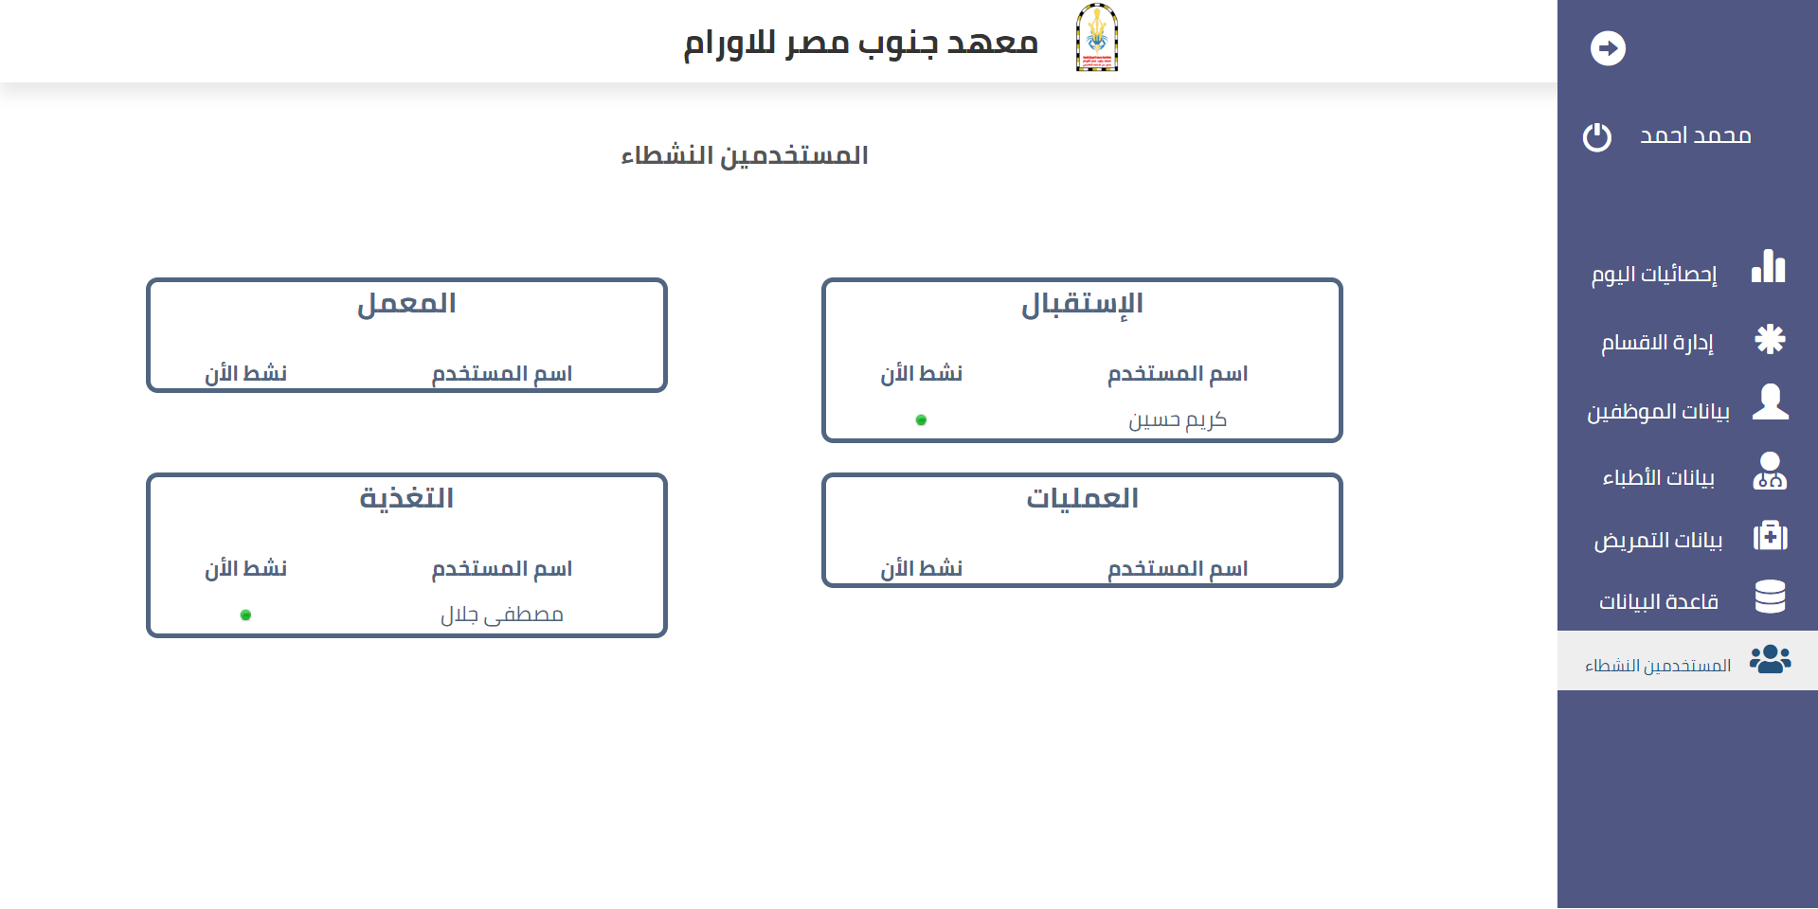
5. Admin

Slide 40
References
https://www.w3schools.com/
https://www.iconfinder.com/
https://www.wikipedia.org/
https://stackoverflow.com/
https://fontawesome.com/
http://getbootstrap.com/docs/3.3/components/
https://www.youtube.com/user/OsamaElzero
https://www.w3schools.com/jquery/default.asp
https://jqueryui.com/
https://www.w3schools.com/js/default.asp
https://dev.mysql.com/downloads/file/?id=474210
https://adobe-photoshop.ar.softonic.com/
https://www.free-power-point-templates.com/tag/dark/page/9/

Slide 41
Acknowledgement
We sincerely thank Dr. Ahmed Taloba, for his efforts and fatigue throughout the period of work on the project. Wishing him progress and promotion to the highest positions.
OIA Team

Slide 42
Thank You

